Slide 1
CS310 Operating Systems Lecture 36 : File System - 4
Ravi Mittal
IIT Goa

Slide 2
Acknowledgements !
Contents of this class presentation has been taken from various sources. Thanks are due to the original content creators:
Book: Modern Operating Systems by Andrew Tanenbaum and Herbert Bos,
Chapter 4
Book: Linux System Programming: talking directly to the kernel and C library, by Robert Love
Book: Computer Systems, A programming Perspective, Bryant and O’Hallaron
Class presentation: University of California, Berkeley, CS162

Slide 3
Read the following:
Book: Modern Operating Systems, by Andrew Tanenbaum and Herbert Bos
Chapter 4
Book: Linux System Programming: talking directly to the kernel and C library, by Robert Love

Slide 4
We will study..
Where are we (File Systems)?
C Library APIs
Buffered I/O (File System): Introduction
Buffered I/O File Operations

Slide 5
Where are we ?

Slide 6
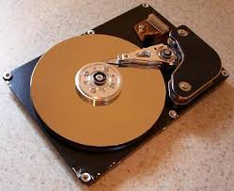
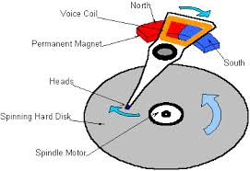
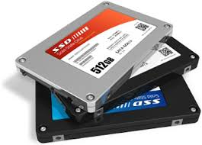

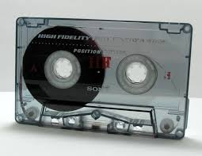
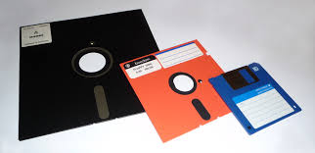
I/O and Storage Layers
Application / Service
High Level I/O
Streams
Low Level I/O
File Descriptors
Syscall
open(), read(), write(), close(), …
Open File Descriptions
File System
Files/Directories/Indexes
Last Class
I/O Driver
Commands and Data Transfers
Disks, Flash, Controllers, DMA
CS 162, Univ of California Berkeley

Slide 7
I/O and Storage Layers
Application / Service
We will study
High Level I/O
Streams
Low Level I/O
File Descriptors
Syscall
open(), read(), write(), close(), …
Open File Descriptions
File System
Files/Directories/Indexes
I/O Driver
Commands and Data Transfers
Disks, Flash, Controllers, DMA
CS 162, Univ of California Berkeley

Slide 8
File Access
Sequential access
Read from the beginning
Can’t skip around
Corresponds to magnetic tape
Random access
Start from anywhere
Example: disks
Necessary for many applications
Database systems

Slide 9
The File Abstraction
High-Level File I/O: Streams
Low-Level File I/O: File Descriptors
We know

Slide 10
The File Abstraction
Today
High-Level File I/O: Streams
Low-Level File I/O: File Descriptors

Slide 11
C Library API
Buffered I/O - Introduction

Slide 12
C library High level APSs vs Linux Syscalls
A C library function implementation
C interface the library provides to programmers to access kernel related functions
If a C programmers directly uses file syscalls, he/she needs to read the documentation
Each syscall has a number of arguments – makes programming complicated
A user, most of the time, may not use all arguments
User space programs are expected to find out arguments for each syscall by inspecting the documentation
Adapted from: Linux programming: Robert Love

Slide 13
C library High level APIs vs Linux Syscalls
Example: fopen() is a library function which provides buffered I/O services for opening a file while open() is a system call that provides non-buffered I/O services
Standard library file operations don’t directly use file descriptors
In standard I/O parlance, an open file is called a stream
However, Syscalls use file descriptors
stream = fopen ("/etc/manifest", "r");
fd = open ("/home/kidd/madagascar", O_RDONLY);
Adapted from: Linux programming: Robert Love

Slide 14
User-Buffered I/O
The block is an abstraction representing the smallest unit of storage on a filesystem
Inside the kernel, all filesystem operations occur in terms of blocks
No I/O operation may execute on an amount of data less than the block size
If you only want to read a byte, you’ll have to read a whole block
Even to read and modify a byte, you will have to perform operations on whole block
Partial block operations are inefficient
User applications don’t work this way..
They use abstractions: byte, strings, etc - independent of block size
Example: Reading a single byte 1024 times vs reading a single 1024 bytes once
Adapted from: Linux programming: Robert Love

Slide 15
User Buffered I/O
To improve performance, data can be buffered internally by delaying writes and reading ahead
In practice, blocks are usually 512, 1,024, 2,048, 4,096, or 8,192 bytes in size
Buffers are usually multiple of block sizes: 4096 or 8192 bytes

Slide 16
User-Buffered I/O
Buffering is done in the user space
Transparently in a library
Writing
As data is written, it is stored in a buffer inside the program’s address space
When the written data size reaches a set size – buffer size – entire buffer is written out (to disk) in a single write operation
Which means it’s written to the underlying file descriptor
Reading
Data is read (from disk) using buffer-sized block aligned chunks
Application’s various sized read requests are served out from this buffer – say one byte at a time
When buffer is empty, another block-aligned chunk is read in
Overall less system calls
Adapted from: Linux programming: Robert Love

Slide 17
User-Buffered I/O
You can design and implement user buffering by hand in your own program
Many mission critical applications do this
Vast majority of programs use
Popular standard I/O library (as a part of standard C library)
iostream library (as a part of standard C++ library)
Adapted from: Linux programming: Robert Love

Slide 18
Buffered I/O – File Operations

Slide 19
Standard I/O library – File Operations
Standard I/O routines
Do not operate directly on file descriptors
Use their own unique identifier, known as the file pointer
Inside C library, file pointer maps to a file descriptor
File pointer is represented by a pointer to the FILE typedef
That is defined in <stdio.h>
In standard I/O parlance, an open file is called a stream
Streams may be opened for reading or writing or both
Adapted from: Linux programming: Robert Love

Slide 20
Opening a file
#include <stdio.h>
FILE *fopen( const char *path, const char *mode );
This function opens the file path with the behavior given by mode and associates a new stream with it.

Slide 21
Modes
Mode Text | Descriptions
r | Open existing file for reading. The stream is positioned at the start of the file
w | Open for writing. If the file exists, it is truncated to zero length. If the file doesn’t exist it is created. Stream is positioned at the beginning of the file
a | Open for appending; created if does not exist. The stream is positioned at the end of the file
r+ | Open existing file for reading & writing. Stream is positioned at the start of the file
w+ | Open for reading & writing; truncated to zero if exists, create otherwise. The stream is positioned at the beginning of the file
a+ | Open for reading & writing. Created if does not exist. Read from beginning, write as append. Read from the beginning and write from the end.

Slide 22
Opening a file
FILE *stream
stream = fopen(“/home/ravi/exam.txt”, ”r”);
If (!stream)
/*error */
Upon success, fopen() returns a valid FILE pointer
On failure it returns NULL and sets errno appropriately
FILE* represents a stream which is assigned to a variable – file pointer stream

Slide 23
read() syscall vs fread() API - User space
Int main(){
int fd = open(“foo.txt”, “O_RDONLY”); // for I/O syscall
FILE *fs = fopen(‘bar.txt”, “w”); // for C lib I/O
User space
Process 1101
main
fd
fs
fd1
buff
3
4
struct sfio-s (aka FILE)
Call stack
Heap

Slide 24
Closing Streams
The fclose() function closes a given stream:
#include <stdio.h>
int fclose (FILE *stream);
Any buffered and not-yet-written data is first flushed
On success, fclose() returns 0
On failure, it returns EOF and sets errno appropriately
fcloseall() function closes all streams associated with the current process

Slide 25
C API Standard Streams
Three predefined streams are opened implicitly when a program is executed
FILE *stdin – normal source of input, can be redirected
FILE *stdout – normal source of output, can be redirected
FILE *stderr – diagnostics and errors, can be redirected
STDIN / STDOUT enable composition in Unix
All can be redirected
cat hello.txt | grep “World!”
cat’s stdout goes to grep’s stdin

Slide 26
Reading Files – Multiple Functions
Once file is open, we can read input from it
We use one of three functions:
fgetc, fgets, fread
fgetc
Useful when you want to read one character (eg letter) at a time
int fgetc(FILE * stream);
This function reads the next character from stream
returns it as an unsigned char cast to an int
The return value of fgetc() must be stored in an int
EOF is returned when end of file or error
Reading the character advances the current position in the stream

Slide 27
Reading an entire line
The function fgets() reads a string from a given stream:
#include <stdio.h>
char * fgets (char *str, int size, FILE *stream);
This function reads up to one less than size bytes from stream
Stores the results in str
A null character (\0) is stored in the buffer after the last byte read in
Reading stops after an EOF or a newline character is reached

Slide 28
Reading Binary Data
Some developers want to read binary data such as C structures
fread()
#include <stdio.h>
size_t fread (void *buf, size_t size, size_t nr, FILE *stream);
Read up to nr elements of data, each of size bytes into the buffer pointed at by buf

Slide 29
Writing to a stream
Writing a single character
#include <stdio.h>
int fputc (int c, FILE *stream);
Writing a string of characters
#include <stdio.h>
int fputs (const char *str, FILE *stream);
Writing Binary Data
#include <stdio.h>
size_t fwrite (void *buf, size_t size,
size_t nr, FILE *stream);

Slide 30
Random Access
int fseek(FILE *stream, long int offset, int whence);
offset (SEEK_SET)
offset (SEEK_END)
whence
offset (SEEK_CUR)
Sets file position pointer to a specific position
Stream: pointer returned by fopen
Offset: The position to seek to, relative to one of the positions specified by whence
whence: The position from which to apply the offset; 3 positions
SEEK_SET – seek starts at beginning of file
SEEK_CUR – seek starts at current location in file
SEEK_END – seek starts at end of file

Slide 31
Many more – Stream Ops
// formatted
int fprintf(FILE *restrict stream, const char *restrict format, ...);
int fscanf(FILE *restrict stream, const char *restrict format, ...);
Notes:
Block oriented: The actual bytes for the integer are written to the file.

Slide 32
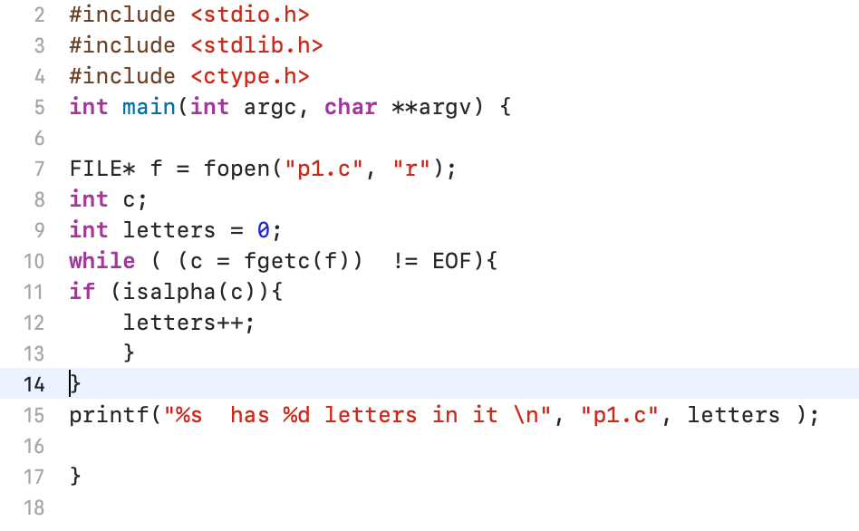
A sample program – character oriented streaming

Slide 33
Program using Syscalls

Slide 34
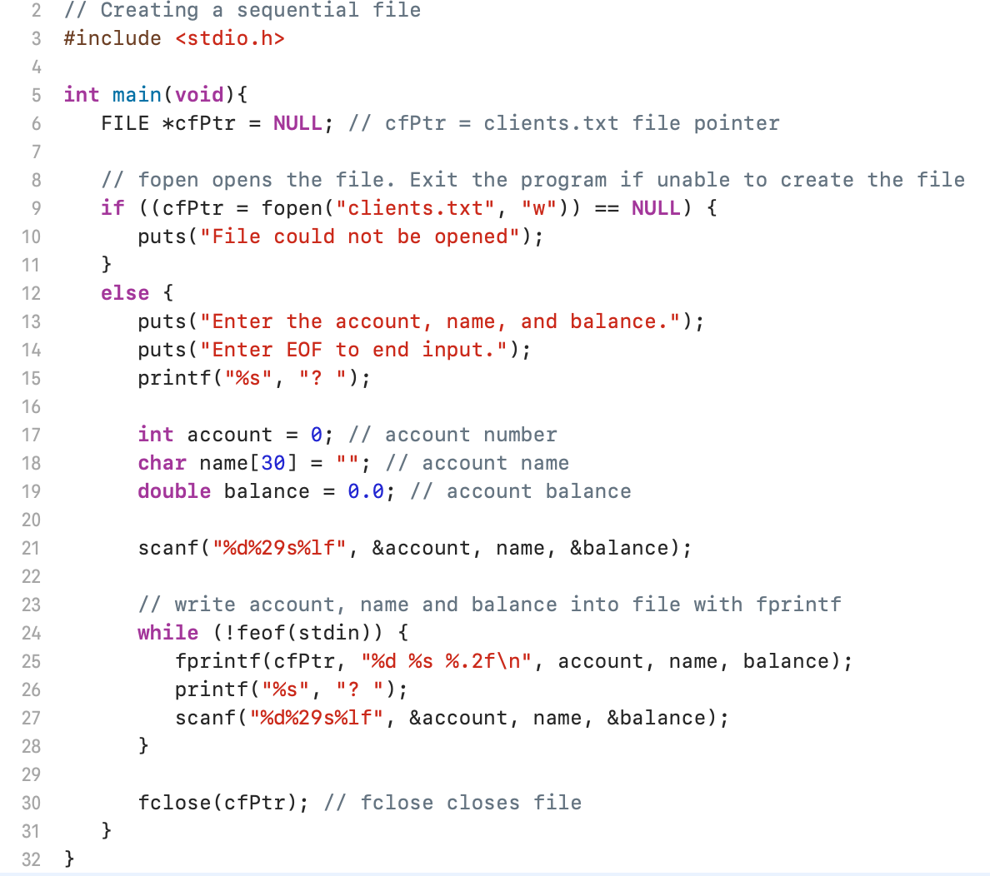
pfile2.c

Slide 35
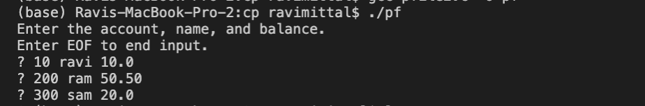
$ cat clients.txt
EOF character
Linux/MAC OS : <Ctrl> d
Windows: <Ctrl> z enter

Slide 36
Lecture Summary
Standard I/O is a user-buffering library provided as part of the standard C library
Buffered file operations are useful when
You issue many system calls
Performance is crucial
Your access patterns are character- or line-based
You want interfaces to make such access easy without issuing extraneous system calls
You prefer a higher-level interface to the low-level Linux system calls

